Slide 1

Introduction to data visualization

Slide 2
Introduction to data visualization
Read Complex JSON files
Styling Tabulation
Distribution of Data –
Histogram
Box Plot
Pie Chart
Donut Chart
Stacked Bar Plot
Relative Stacked Bar Plot
Stacked Area Plot
Scatter Plots
Bar Plot
Continuous vs Continuous Plot
Line Plot

Slide 3
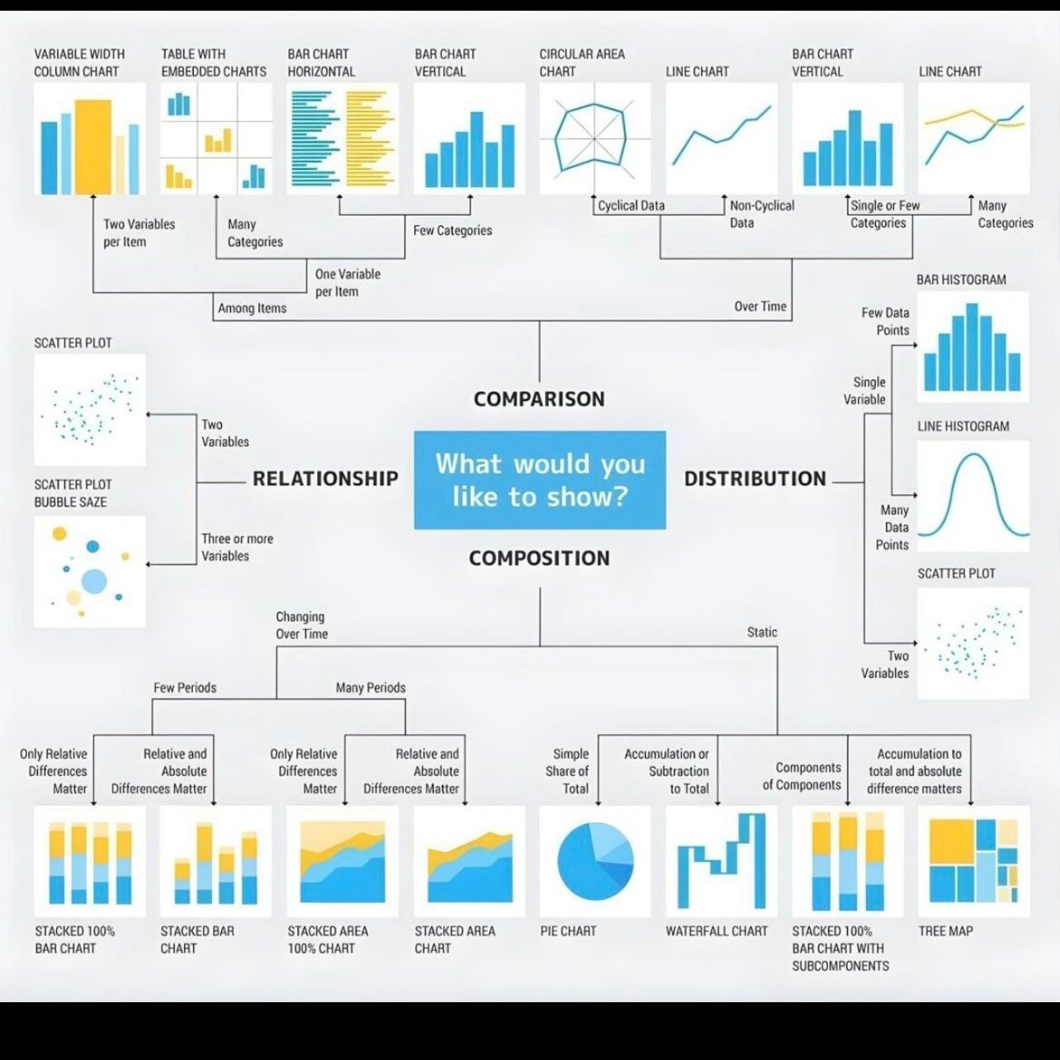

Slide 4

Read Complex JSON files
What is a JSON file?
JSON (JavaScript Object Notation) is an open standard file format for sharing data that uses human-readable text to store and transmit data.
JSON files are stored with the .json extension.
JSON requires less formatting and is a good alternative for XML(eXtensible Markup Language).
JSON is derived from JavaScript but is a language-independent data format.
The generation and parsing of JSON is supported by many modern programming languages.
application/json is the media type used for JSON.

Slide 5
JSON File Structure
JSON data is written in key/value pairs.
The key and value are separated by a colon(:) in the middle with the key on the left and the value on the right.
Different key/value pairs are separated by a comma(,).
The key is a string surrounded by double quotation marks for example “name”.
The values can be of the following types.

Slide 6
Number
String: Sequence of Unicode characters surrounded by double quotation marks.
Boolean: True or False.
Array: A list of values surrounded by square brackets, for example
[ "Apple", "Banana", "Orange" ]
Object: A collection of key/value pairs surrounded by curly braces, for example
{"name": "Jack", "age": 30, "favoriteSport" : "Football"}
JSON objects can also be nested to represent the structure of the data. Given below is an example of a JSON object.

Slide 7
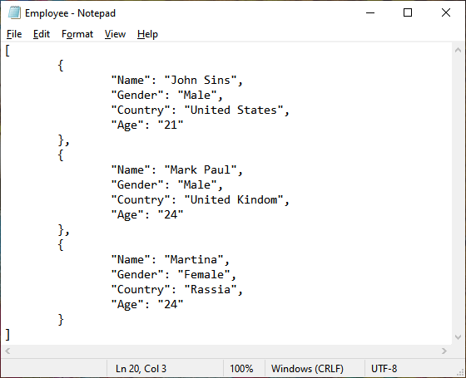

Slide 8

How to read JSON file in EXCEL

Slide 9
Styling Tabulation

Slide 10
Distribution of Data –
Bar Plot
Line Plot
Pie Chart
Donut Chart
Stacked Bar Plot
Relative Stacked Bar Plot
Stacked Area Plot
Continuous vs Continuous Plot
Box Plot
Scatter Plots
Histogram

